Slide 1


Introduction to Decision Trees
Notes:
Decision Trees are popular machine learning models that can be used for both classification and regression applications. Decision trees can produce a set of rules that can be easily interpreted and understood by humans and therefore are considered as being transparent. In this module, we will introduce the key idea behind decision tree models and then we will discuss classification and regression trees known as CART. The concept of tree pruning is then introduced. Finally, implementation of decision trees in R is illustrated and discussed.

Slide 2
Decision Trees
A decision tree model is a model that uses a tree-like graph or model of decisions and their possible consequences.
It is one way to display an algorithm that only contains conditional control statements.
In a decision tree each internal node represents a "test" on an attribute, each branch represents the outcome of the test, and each leaf node represents one of the potential outputs of the tree.
Notes:
So what are decision trees? Well, decision trees are machine learning method used for classification and regression as we have seen before. The goal is to create a model that predicts the value of a target variable by learning simple decision rules inferred from the dataset. In simple words, a decision tree is nothing but a sequence of conditional control statements. In this context, we ask a series of questions or perform tests on different attributes until the final outcome is given at the end. Depending on the answer to each question, each node of the tree is divided into two branches until a final node or a leaf is reached.

Slide 3
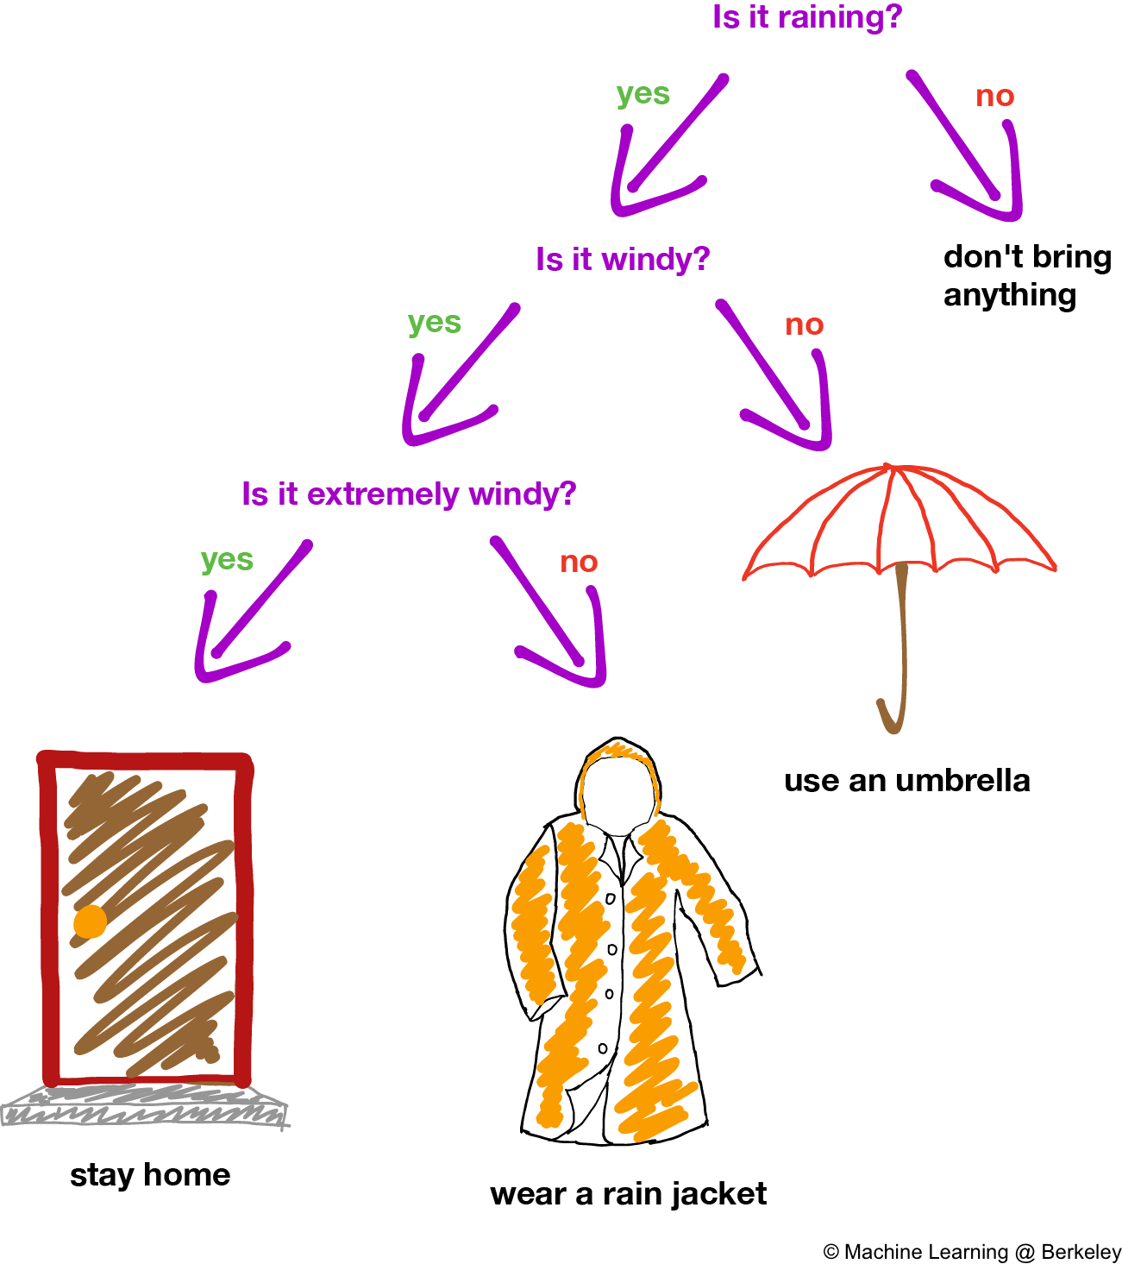
Example:
Notes:
https://ml.berkeley.edu/blog/2017/12/26/tutorial-5/
So let’s consider an example; in this example we want to define a course of action depending on the weather. So, the first question is if it is raining. If it doesn’t rain then we don’t need to prove anything. If it is raining then the second question would be is it windy as well or not. If it is not windy, then we only need to use an umbrella. However, if it is windy, the third question would be if it is extremely windy or not; if not, then we should wear a jacket. Otherwise if it is extremely windy we should stay at home. So in this example, you can see a series of questions or tests, on various attributes. Attributes considered in here where whether the weather was rainy, whether it was windy, or whether it was extremely windy.

Slide 4
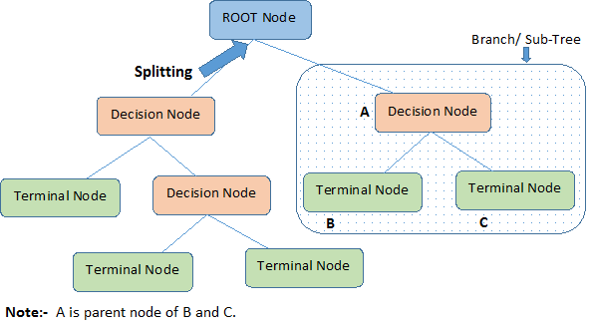
Terminology related to Decision Trees
Root Node: It represents entire population or sample.
Splitting: It is a process of dividing a node into sub-nodes.
Decision Node: When a sub-node splits into further sub-nodes, then it is called decision node.
Leaf/ Terminal Node: Nodes do not split is called Leaf or Terminal node.
Notes:
Now let’s consider some of the terminology related to decision trees. So, in every decision tree we would have root nodes, decision nodes, and leaves. So, root nodes stay at the top of the tree and represent the entire population. Now splitting refers to the process of dividing a population and a node into two sub nodes. With this in mind, a decision node can be considered as a node where splitting happens. So basically, decision nodes are nodes where we are performing the tests on various attributes. Leaves, or terminals, are the final nodes where there are no further tests on any of the attributes.

Slide 5
Types of Decision Trees
Classification Decision Tree: Decision Tree which has categorical target variable then it called classification decision tree.
Regression Decision Tree: Decision Tree has continuous target variable then it is called as Regression Decision Tree.
Notes:
So we basically have two type of decision trees, classification decision trees and regression decision trees. In classification decision trees, the output is a category, as we have seen before, whereas in regression decision trees, a numeric value would be the output of the tree. In other words, in the classification decision tree, the terminal nodes are used to define which category a given observation belongs to, whereas in regression trees, each final, or each terminal, node would represent a numerical number.

Slide 6
Advantages of Decision Trees
Easy to Understand: Decision tree output is very easy to understand even for people from non-analytical background.
Useful in data exploration: Decision tree is one of the fastest way to identify most significant variables and relation between two or more variables.
Data type is not a constraint: It can handle both numerical and categorical variables.
No assumption about the data: Decision trees have no assumptions about the space distribution and the classifier structure.
Notes:
So what are the key advantages of using decision trees. Well to start, decision trees are generally considered as easy to understand. Decision tree output is very easy to understand, even for people from a non-analytical background. It does not require any statistical knowledge to read and interpret a series of logics and output of the trees. Also, its graphical representation is very intuitive, and the user can easily relate their hypotheses. Decision trees are also considered as being very useful in data exploration. In fact, decision trees are one of the fastest ways to identify most significant variables and relationship between two variables or more. With the help of decision trees we can create new variables and features that have better power to predict target variables. Also, decision trees can well handle both numerical and categorical variables, which is a great advantage. Decision trees are considered to be non-parametric methods, which means that the decision tree does not have any assumption about the distribution or the structure of the underlying data.

Slide 7
Disadvantages of Decision Trees
Sub-optimal Accuracy: The accuracy of single decision trees are shown to be
Not fit for continuous variables: While working with continuous numerical variables, decision tree looses information when it categorizes variables in different categories
Notes:
Despite all the advantages, decision trees also come with some disadvantages as well. First of all, the accuracy or the predictive power of the decision tree, is considered as being sub-optimal. Secondly, although decision trees can handle both categorical and numerical values, when dealing with the continuous variables, decision trees lose information when it categorizes variables in different categories.

Slide 8
Example Applications of Decision Trees
The following are the common areas for applying decision trees:
Direct Marketing
Customer Retention
Fraud Detection
Diagnosis of Medical Problems
Notes:
Here are a few examples of applications of decision trees in business. Direct marketing, customer retention, fraud detection, and diagnosis of medical problems. Note that these are only a few examples out of many. Considering direct marketing, it should be noted that direct marketing is a form of advertising where organizations communicate directly to customers through a variety of channels. Decision trees can be used to identify best products or services that a given customer may be interested in. Decision trees can also help organizations keep their valuable customers and get new ones by providing good quality products, discounts, or gift vouchers. The company can also analyze the buying behaviors of customers to know their satisfaction level. Fraud is a major problem for many industries; Using classification trees, a business can detect fraud beforehand and draw fraudulent customers. For diagnoses of medical problems, classification trees can be used to identify patients who are at risk from suffering serious diseases such as cancer.

Slide 9
“Our philosophy in data analysis is to look at the data from a number of different viewpoints. Tree structured regression offers an interesting alternative for looking at regression type problems. It has sometimes given clues to data structure not apparent from a linear regression analysis. Like any tool, its greatest benefit lies in its intelligent and sensible application.” --Leo Breiman, Pioneer of Classification and Regression Trees
In predictive analytics, various algorithms are deployed to mine data to find patterns with the goal making predictions.
Predictive analytics systems deploy more complex algorithms and are more computationally intensive
In Predictive Analytics systems the focus is in predicting the future as opposed to describing what has happened in the past which is the focous of BI systems.
Notes:
Pause for 10 seconds

